Slide 1









DATA ANALYSIS
Module 4: Statistic for Analytics
Descriptive Statistics &
Distributions
Topic 1 of 5

Slide 2



MODULE 4 OBJECTIVES
Calculate and interpret mean, median, mode, range and standard deviation, and know when to trust the mean vs. the median
Calculate and interpret a correlation coefficient, and explain why correlation isn't causation
Fit a regression line to predict outcomes, and recognise the limits of the model
Test whether a difference is statistically significant, using a correctly interpreted p-value
Use AI to interpret statistical results responsibly, catching claims that overstate the evidence
Notes:
1.7.2013
1.7.2013
‹#›
‹#›

Slide 3
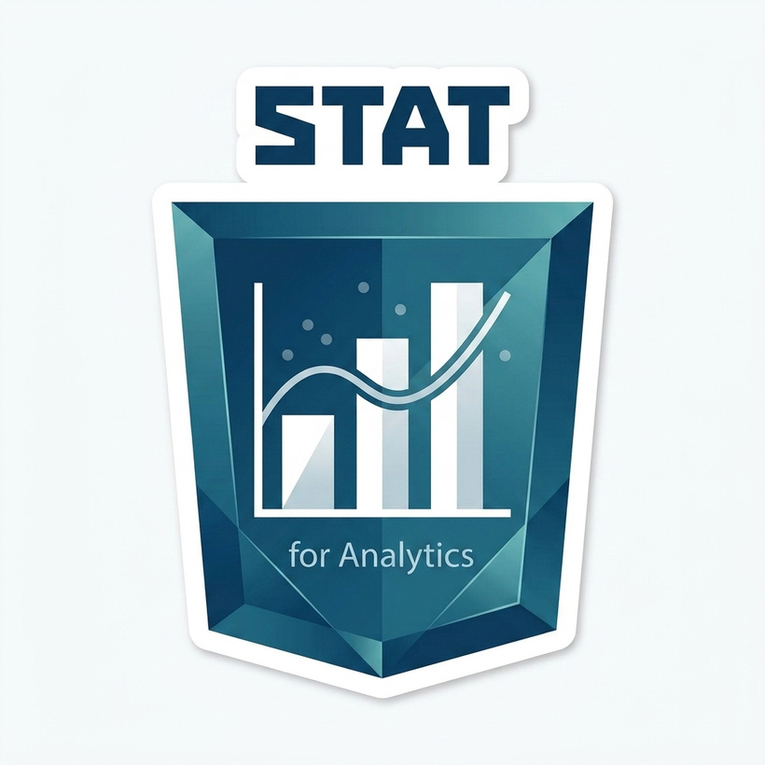





Learning outcome
By the end of this session, you will be able to perform and explain these four core analytical capabilities:
1. Calculate Summary Stats
Calculate and interpret the mean, median, mode, range, and standard deviation of any business dataset using Excel.
2. Handle Data Skew
Choose accurately between the mean and median when data is skewed, and explain the mathematical reason why.
3. Identify Outliers
Detect outliers in a dataset and evaluate their specific distortions on summary statistics before taking action.
4. Business Translation
Translate statistical summaries into clear, plain-language statements that store managers and executives can act on.
Notes:
1.7.2013
1.7.2013
‹#›
‹#›

Slide 4
What is Statistics?
Statistics is the science of conducting studies to collect, organize, summarize, analyze, and draw conclusions from data.
What statistics means in data analytics
Statistics in data analytics refers to the mathematical discipline of collecting, organizing, analyzing, interpreting, and presenting data to uncover patterns, trends, and actionable insights from raw datasets.
Notes:
1.7.2013
1.7.2013
‹#›
‹#›

Slide 5


What is Statistics?
Rreal-World Use Cases of Statistic
A business looking at sales trends
A data analyzing patient vitals
Statistics helps us make sense of data so we can make informed decisions.
Notes:
1.7.2013
1.7.2013
‹#›
‹#›

Slide 6

Class Tasks
"Can you tell us of a time you used data to make a decision?"
Notes:
1.7.2013
1.7.2013
‹#›
‹#›

Slide 7


Case Study: Aduke Stores Lagos
"On a normal day, how many daily customers should I be staffing for at our Ikeja branch?"
— Branch Manager, Aduke Stores Lagos
The Problem: The manager logged footfall across 30 consecutive days. The raw list of 30 numbers does not answer the staffing question by itself.
The Analyst's Job: Summarise a raw list of numbers into 1 or 2 actionable metrics management can use.
Notes:
1.7.2013
1.7.2013
‹#›
‹#›

Slide 8


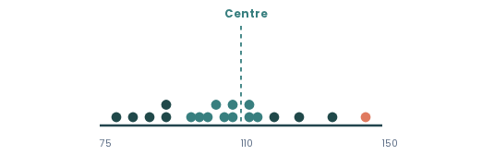

What is a Data Distribution?
Defining "Distribution"
A distribution is simply the full set of values a variable takes, alongside how often each value occurs.
Visualizing Dot Plot Scatter
If you list the customer footfall recorded on all 30 days at Ikeja branch, that list of 30 numbers represents the distribution of "Daily Customers".
Descriptive statistics are the small set of numbers analysts use to describe a distribution without listing every value: a typical value, and how spread out the values are.
Two Questions Every Analyst Must Answer:
30 daily customer counts mapped along a single number line.
1.
Where is the center of the data?
2
How spread out is the data around that center?
Notes:
1.7.2013
1.7.2013
‹#›
‹#›

Slide 9



The Mean: Balancing Point
The mean (often referred to as the average) is the sum of all data values divided by the total number of values.
Business Interpretation:
"On an average day, Ikeja branch served 113 customers."
Σx (Sigma x): Sum of all values in the dataset.
When to use: Excellent as a single planning figure when data is evenly balanced. However, it can be strongly pulled off-centre by a few unusually large or small days.
n: Count of observations (30 days recorded).
Excel Formula:
Notes:
1.7.2013
1.7.2013
‹#›
‹#›

Slide 10



The Median: Middle Value
The median is the exact middle value when all data points are sorted from smallest to largest.
Business Interpretation:
"Half of all days at Ikeja branch had 96 customers or fewer, and half had more."
How to calculate the median:
How to calculate the median:
1.
Sort all values from smallest to largest.
2.
Odd count: Take the single middle value.
When to use: Use when extreme high or low values could distort the mean. The median provides a more robust reflection of a true "normal day".
3.
Even count: Take the average of the 2 middle values.
Excel Formula:
Notes:
1.7.2013
1.7.2013
‹#›
‹#›

Slide 11

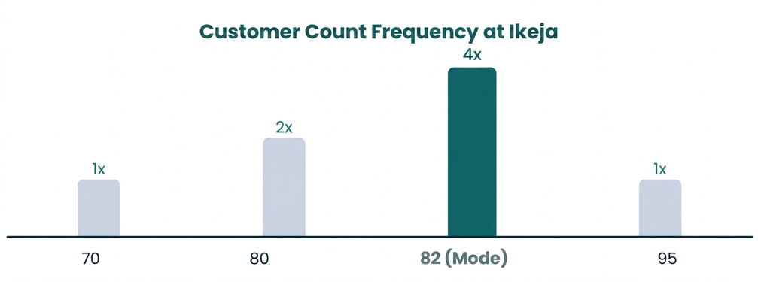
The Mode: Most Frequent Value
The mode is the specific value that occurs most frequently in a dataset.
Business Interpretation:
Characteristics: It measures frequency of occurrence, not a calculated balancing point.
"82 customers was the single most common day count at Ikeja branch, occurring 4 times in the month."
Flexibility: A dataset can have one mode, multiple modes (bimodal/multimodal), or no mode at all.
Excel Formula:
When to use: Highly effective for categorical data (e.g., most popular payment method) or identifying exact inventory/staffing recurring targets.
Notes:
1.7.2013
1.7.2013
‹#›
‹#›

Slide 12
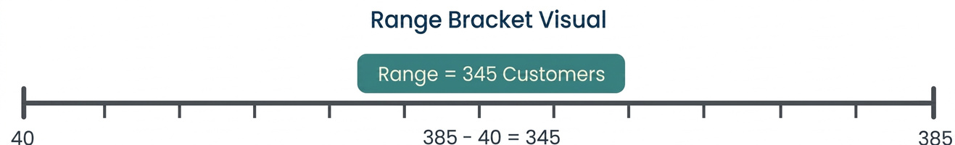
The Range: Total Data Spread
The range represents the difference between the absolute highest and lowest values in a dataset.
Business Interpretation:
"Customer numbers ranged across 345 customers between the quietest and busiest day."
Excel Formula:
Caution: Range uses only two extreme values. A single unusual promotion day can make the dataset look far more volatile than it normally is.
Notes:
1.7.2013
1.7.2013
‹#›
‹#›

Slide 13

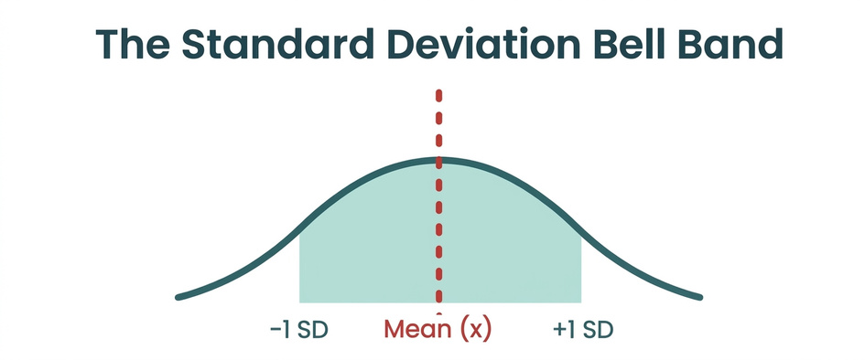
Standard Deviation Explained
The standard deviation measures how far values typically sit from the mean.
Business Interpretation:
"Daily customer numbers at Ikeja typically sit about 62 customers away from the average."
s: Sample standard deviation (x - x̄): deviation from mean | n - 1: sample adjustment
Small STDEV: Consistent, predictable performance. Easy staffing.
Excel Formula:
Large STDEV: Daily result swings widely. Demands buffer staffing (which is a planning risk).
Notes:
1.7.2013
1.7.2013
‹#›
‹#›

Slide 14



Choosing Mean vs. Median
The decision depends on whether the distribution is symmetric or skewed by extreme events.
A dataset is skewed when it has a "long tail" of unusually high or low values pulling away from the bulk of the data. While not skewed when the mean and median sit close together, and either is a fair summary.
Use the Mean
Use the Median
When data is evenly spread without major outliers, mean and median sit close together.
When extreme high or low values pull the mean away from the bulk of the data.
Utilizes every data point in the dataset.
Resists distortion from extreme promo spikes.
Standard input for advanced statistical models.
Reflects the true experience of a normal day.
Notes:
1.7.2013
1.7.2013
‹#›
‹#›

Slide 15



Understanding Outliers
An outlier is a value that sits unusually far from the rest of the data, either much higher or much lower.
Analyst's Golden Rule:
Always run your analysis twice — once with the suspected outlier included, and once with it excluded.
How Outliers Distort Statistics:
Mean: Strongly pulled towards the outlier.
Never quietly delete an outlier!
Median: Remains steady and protected.
Investigate if it is an entry error (typo) or a genuine business event (Black Friday promotion). Report both figures transparently.
Range & STDEV: Inflated dramatically.
Notes:
1.7.2013
1.7.2013
‹#›
‹#›

Slide 16





Worked Example: Ikeja Branch
Impact of 1 Black Friday Promo Day (28 Nov) on 30 Days of Customer Data:
All 30 Days (Promo Included)
29 Ordinary Days (Promo Excluded)
MEAN
MEDIAN
MEAN
MEDIAN
112.9
96.0
102.3
94.0
RANGE
STDEV
RANGE
STDEV
345
61.7
74
21.4
Manager Recommendation:
"For everyday staffing, plan around a typical baseline of 94 to 102 customers. Do not use the 113-customer mean which is artificially inflated by Black Friday. Treat promo days under a separate event staffing plan."
Notes:
1.7.2013
1.7.2013
‹#›
‹#›

Slide 17


Guided Practice: Aduke Stores, Yaba Branch
Open your practice workbook in Excel and analyze the Aduke Stores Yaba branch dataset (in pairs — 8 minutes):
Your Tasks:
Key Excel Formulas Needed:
Calculate the Mean, Median, Mode, Range, and Standard Deviation in Excel.
=AVERAGE(B2:B31)
=MEDIAN(B2:B31)
Determine whether the dataset is skewed or evenly distributed. Justify using numbers.
=MODE.SNGL(B2:B31)
Draft a 1-sentence manager recommendation.
=MAX(B2:B31) - MIN(B2:B31)
=STDEV.S(B2:B31)
Notes:
1.7.2013
1.7.2013
‹#›
‹#›

Slide 18

Key Takeaways
Calculate the mean, median, mode, range and standard deviation of a dataset in Excel, and explain what each one measures.
Up Next: Correlation
Decide whether to trust the mean or the median for a given dataset, based on whether the data is skewed.
3Spot an outlier in a dataset and explain how it distorts summary statistics if left unaddressed.
Turn a set of statistics into a single, plain-language recommendation a manager could act on.
Notes:
1.7.2013
‹#›

Slide 19



Up Next: Correlation (4.2)
One Variable at a Time
Two Variables Together
Analyzing univariate distributions: understanding footfall, averages, and variability on a single metric.
Analyzing bivariate relationships: Does higher marketing spend at Aduke Stores drive higher daily sales?
Action Items Before Next Class:
Complete Topic 4.1 LMS Practice Questions & Lab Exercises on publica.academy
Notes:
1.7.2013
‹#›

